Slide 1
AWS GridMate

Slide 2
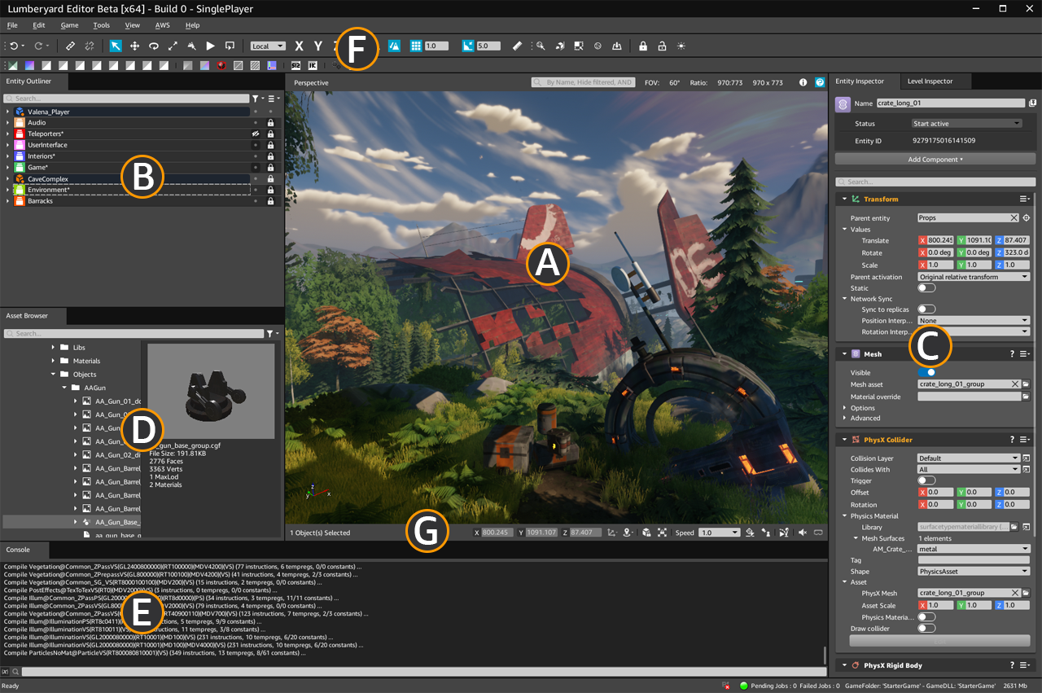
Game Dev
Lumberyard Game Editor
https://docs.aws.amazon.com/lumberyard/latest/welcomeguide/wg-editor.html

Slide 3

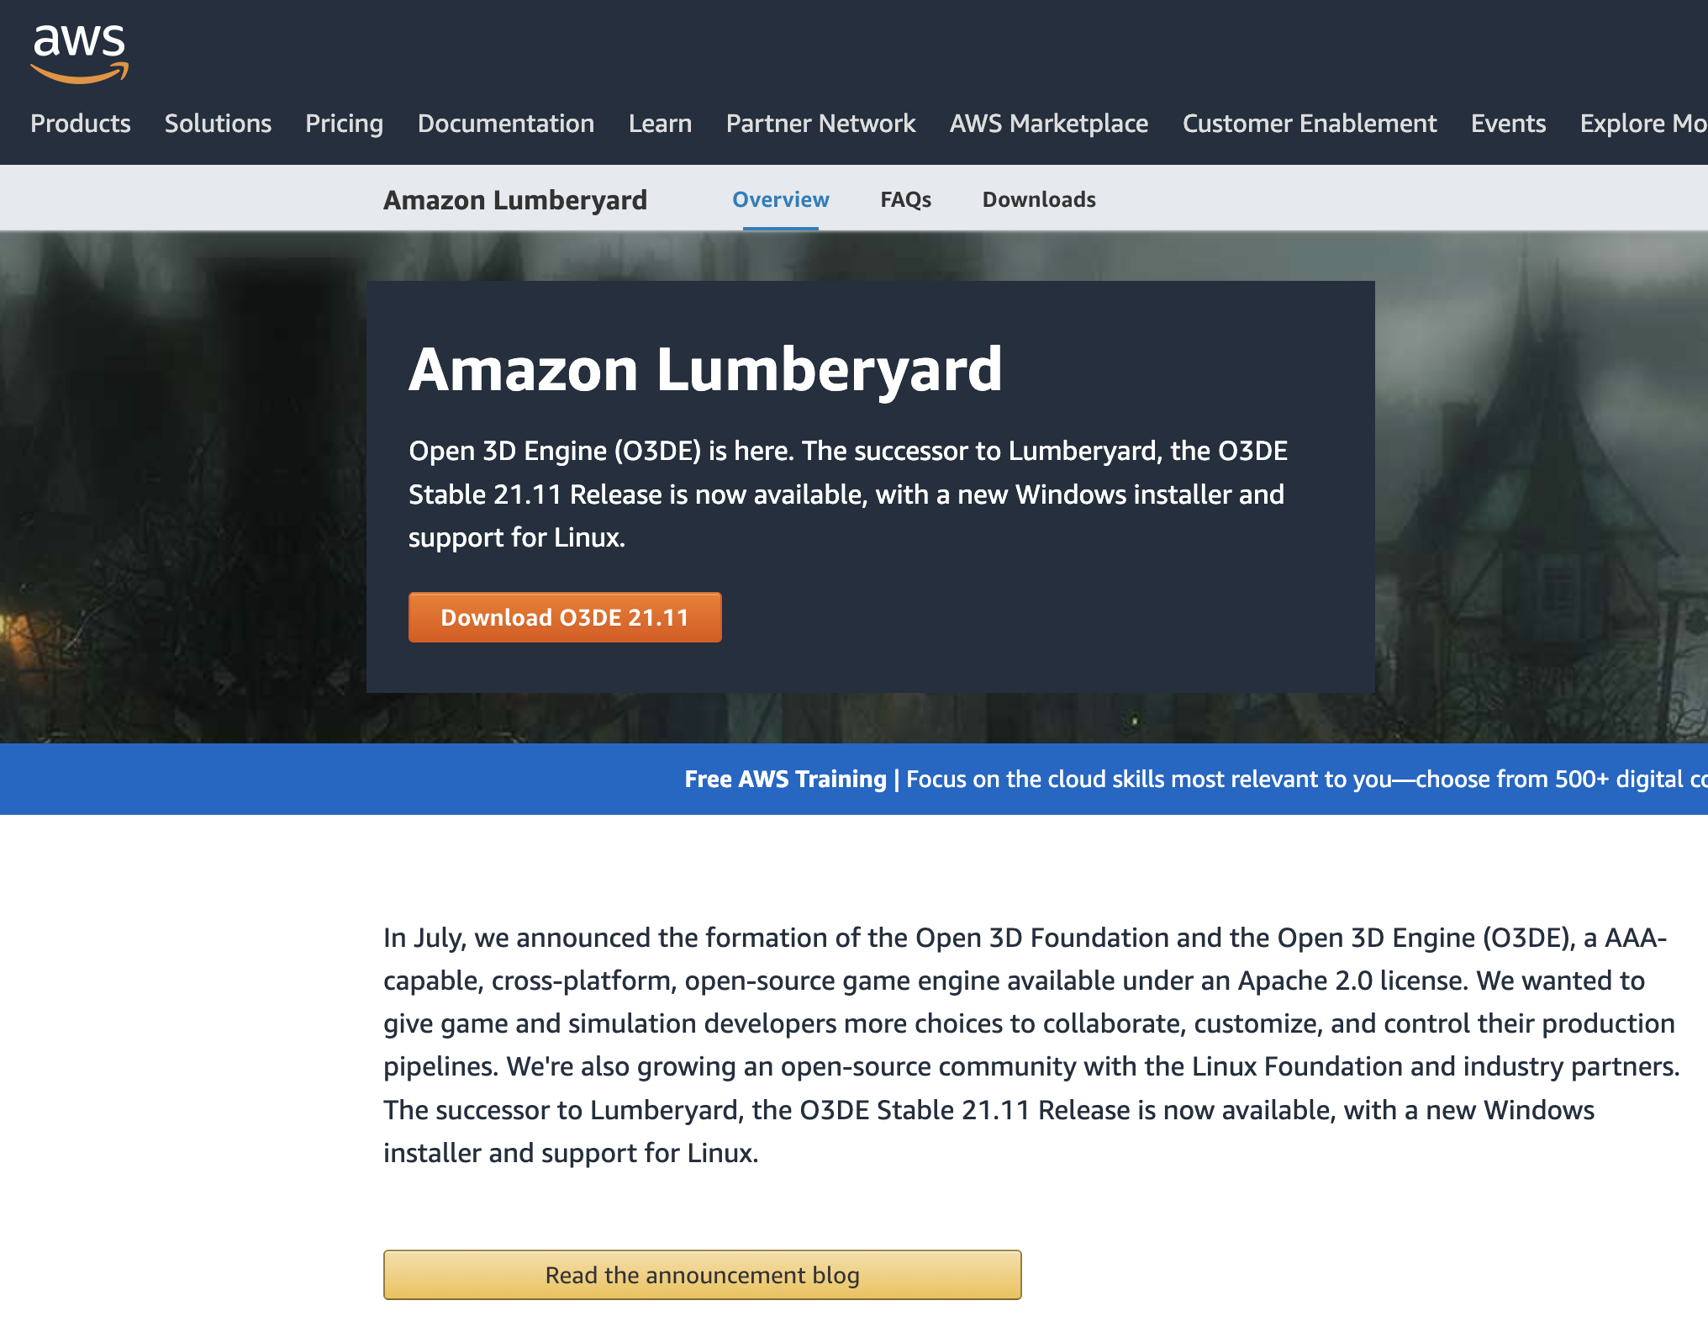
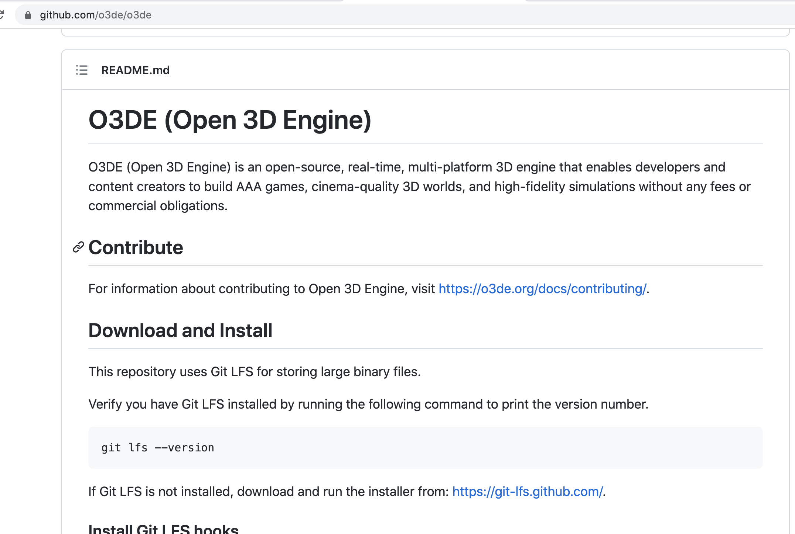
Open Source

Slide 4


Single-player vs Multiple-players

Slide 5
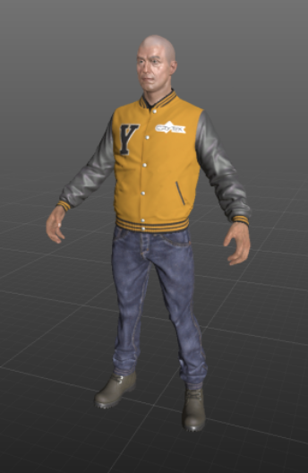
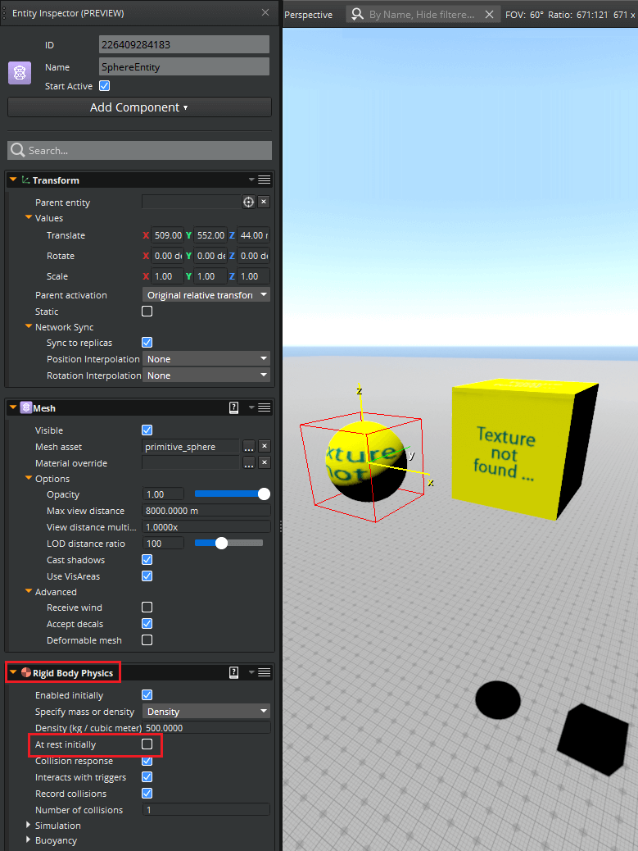
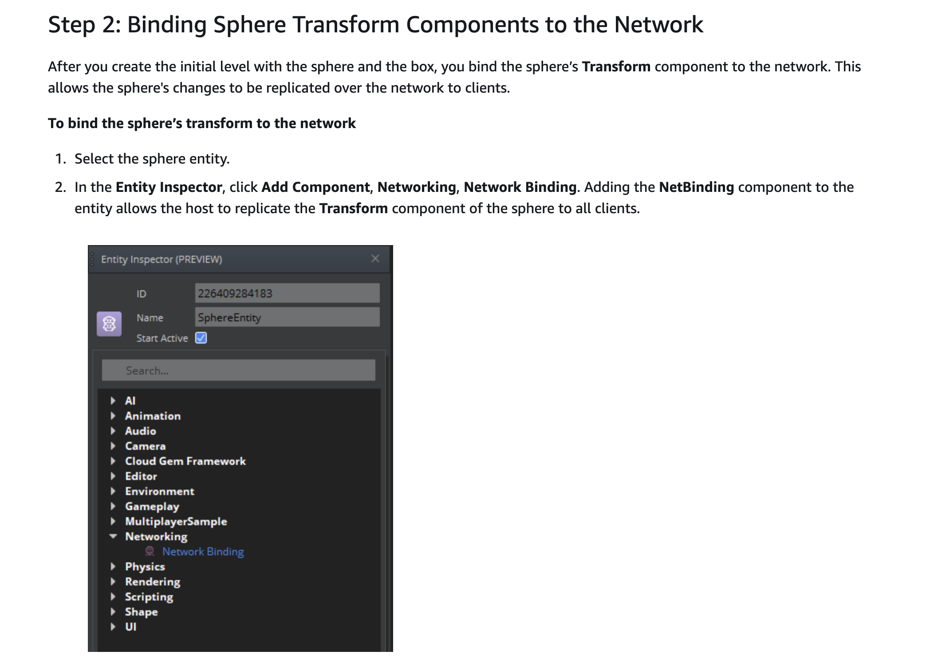
Multiple-players
“You have now created a server authoritative sphere entity that enables changes to the sphere to replicate over the network.”

Slide 6
Client-Server vs Server-Server
“Server Authoritative” vs “Client authoritative”
Server
Server
Server
Client
Client
Server
Server
Client

Slide 7
状态同步 vs 帧同步
Server
Server
Action (“A” hits “B”)
State (“B” dead)
Action (“A” hits “B”)
Action (“A” hits “B”)
Client
Client
State (“B” dead)
Client
Client
State (“B” dead)
Action (“A” hits “B”)
Client
Client

Slide 8
Primary vs Replica
Replica data
Primary data
最终一致性
Replica data
Replica data
Server
Primary data
Primary data
Server
Server
Replica data
Replica data
Replica data
Client
Client
Server
Server
Replica data
Replica data
Replica data
Client

Slide 9
Primary vs Replica
Replica data
Primary data
最终一致性
Replica data
Replica data
Server
Primary data
Server
Server
Replica data
Replica data
Replica data
Replica data
Client
Client
Server
Server
Primary data
Replica data
Replica data
Client

Slide 10
Manage Replication
Server
Primary data
?
Replica data
Replica data
Client
Client
Replica data
Client

Slide 11
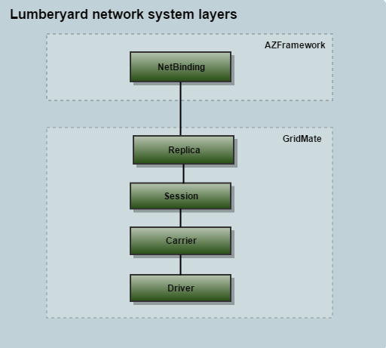
AWS GridMate
A library that enables you to easily add online features to your games on multiple operating systems and devices.
The GridMate API library has two general categories:
network synchronization
online systems.

Slide 12
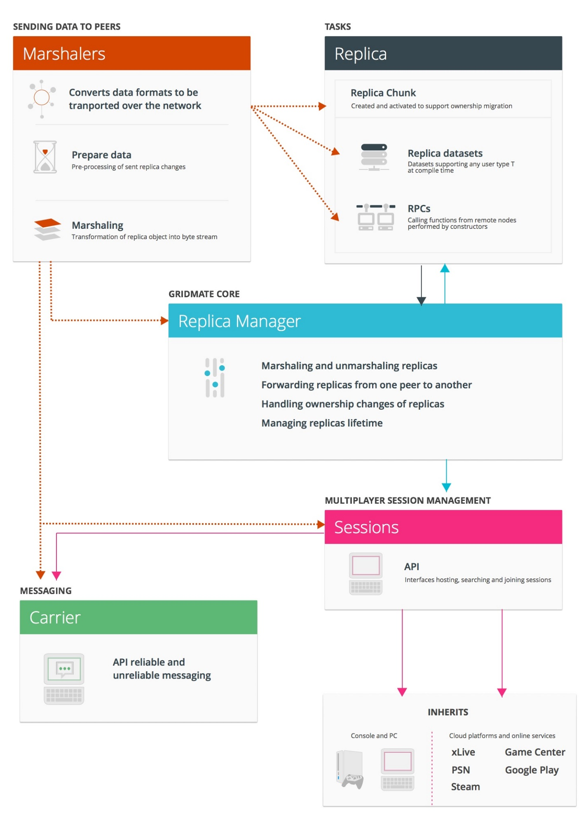
AWS GridMate
A library that enables you to easily add online features to your games on multiple operating systems and devices.
The GridMate API library has two general categories:
network synchronization
online systems.

Slide 13
Network Layering
Game Entity
Game Entity
Game Entity
NetBindingComponent
NetBindingComponent
Secondary Replica
Secondary Replica

Slide 14
Session: Network topology
Carrier: Messaging via channel
Carrier: Low level socket & drivers
Node
Replica manager
Node
Replica manager
Replica
Secondary
Replica
Node
Primary
Replica
Secondary
Replica manager

Slide 15
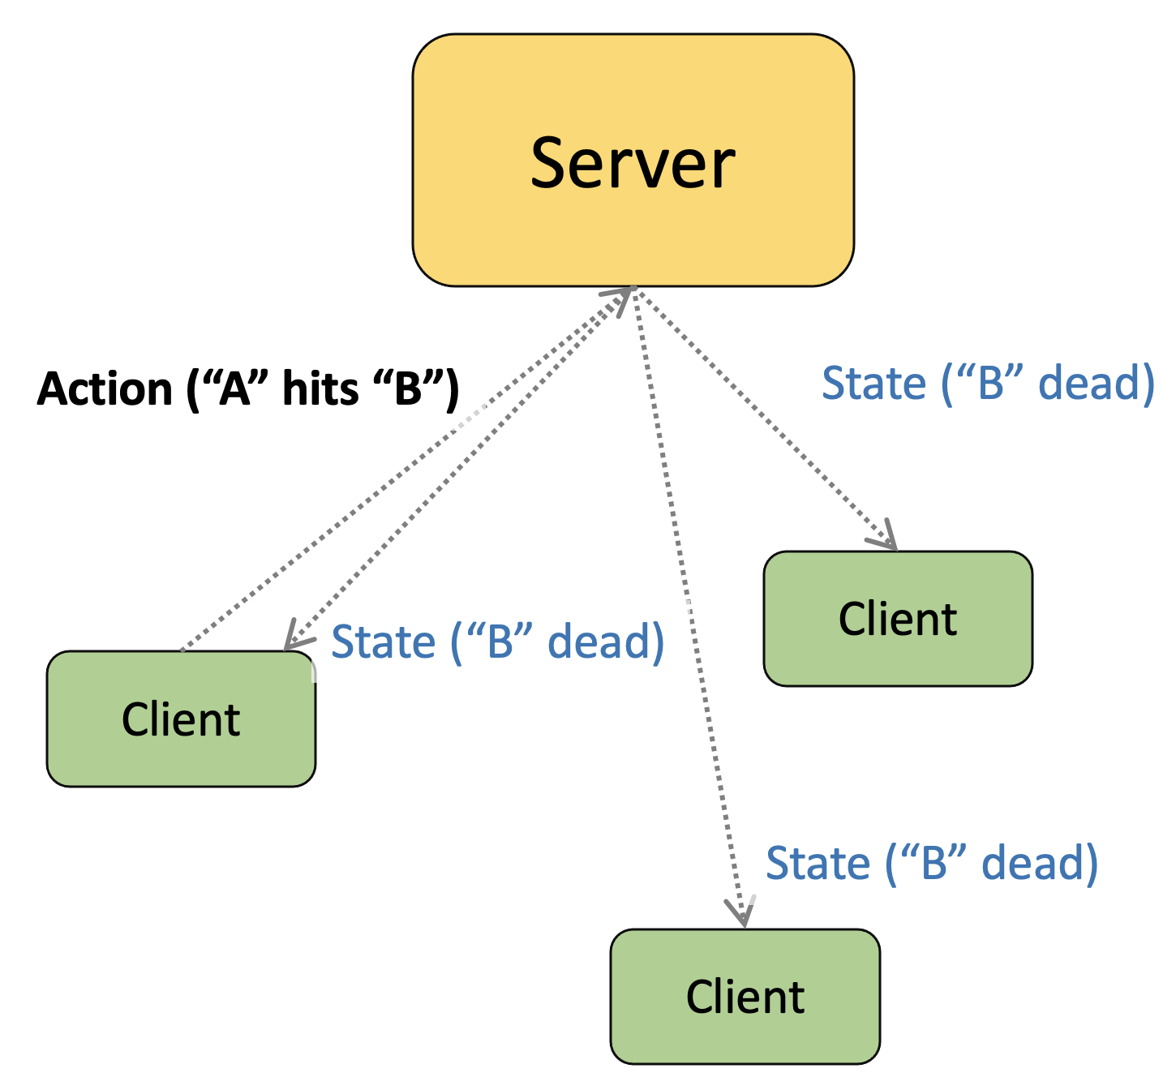
What about large scale?

Slide 16
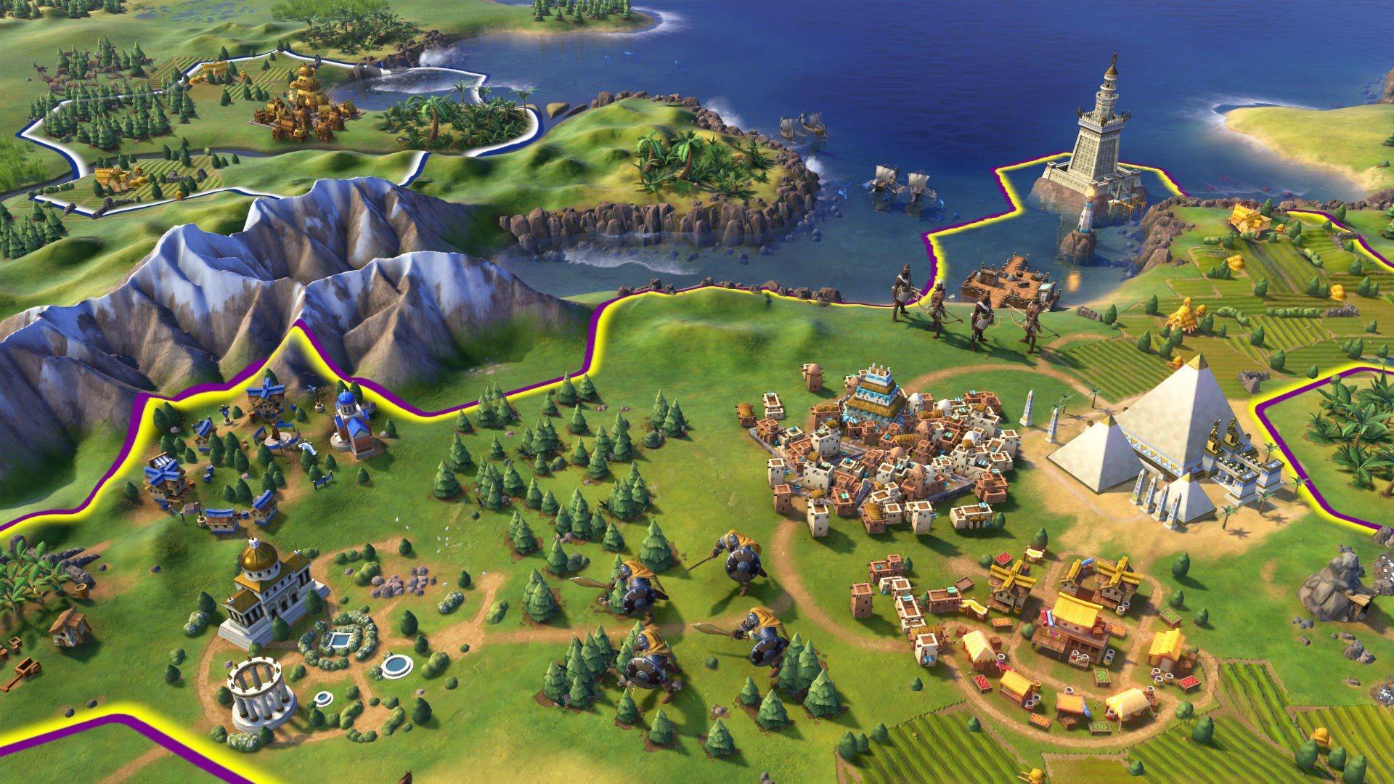
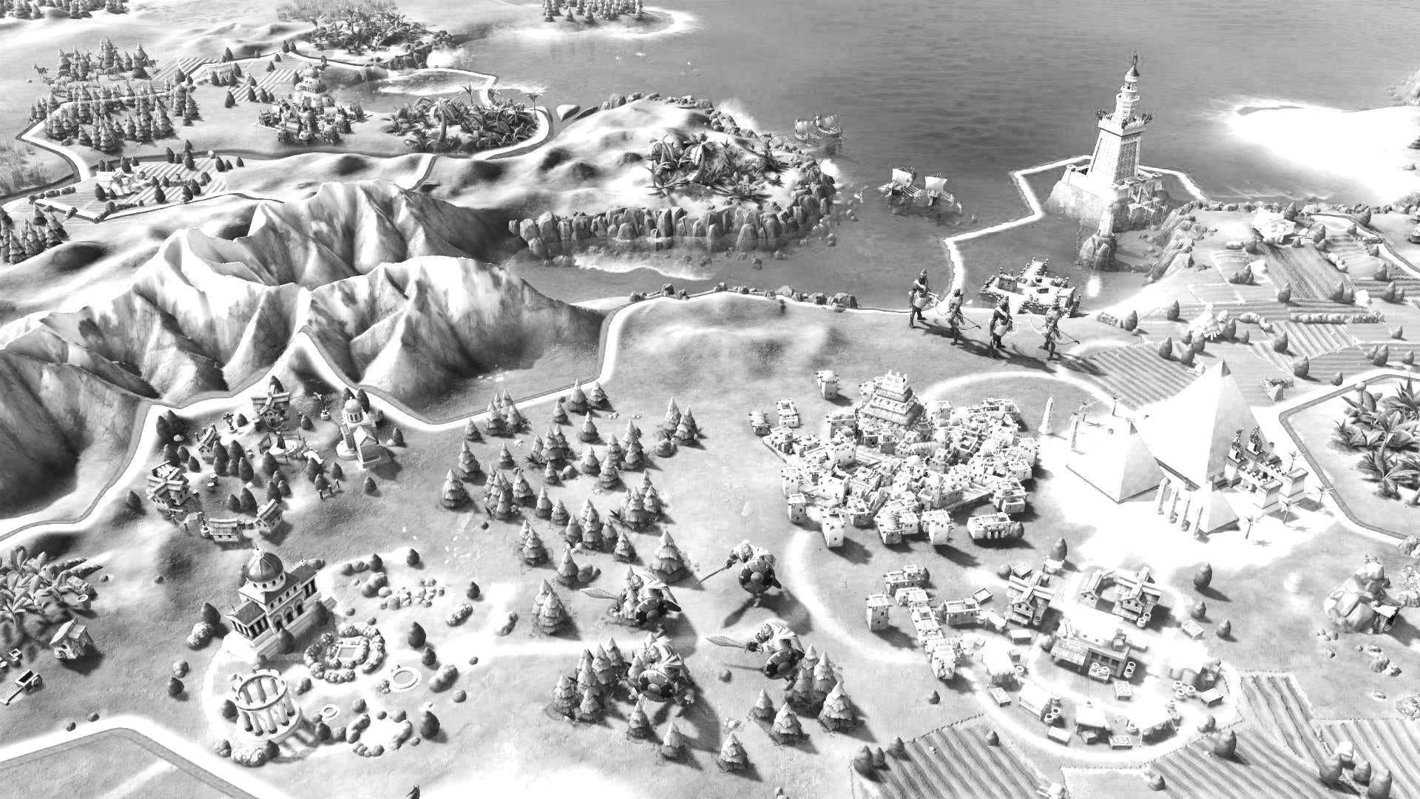
Interest Based Filtering
Server
Client
Client

Slide 17
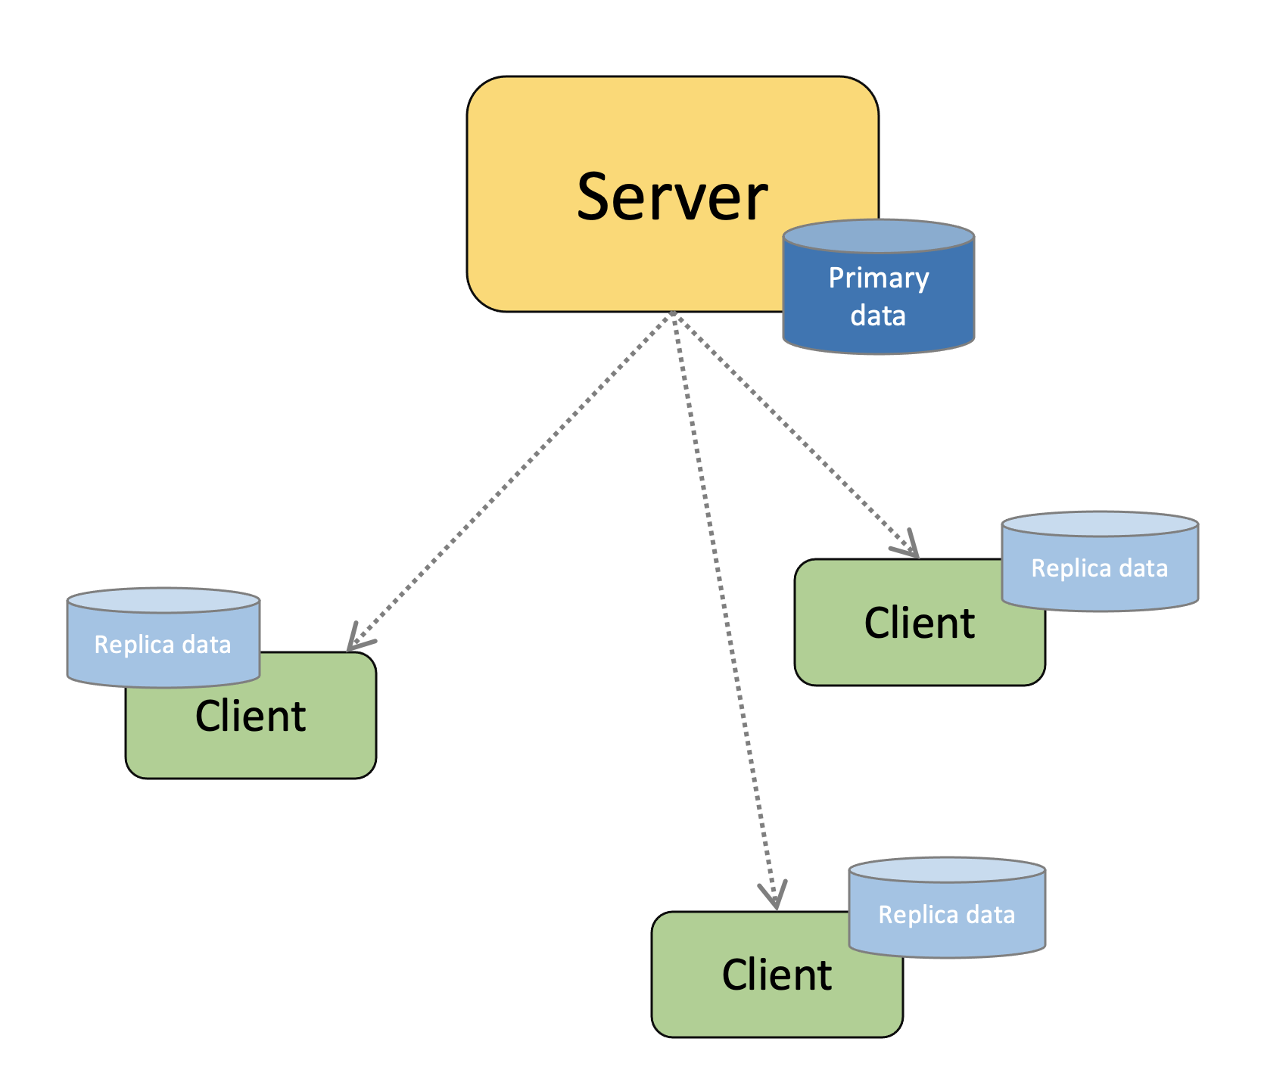
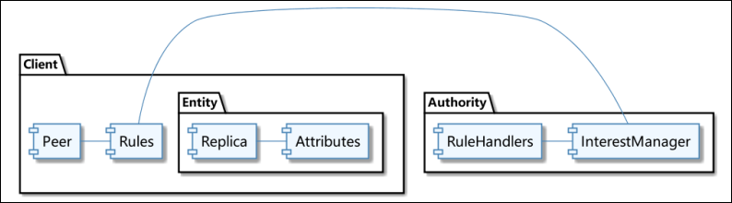
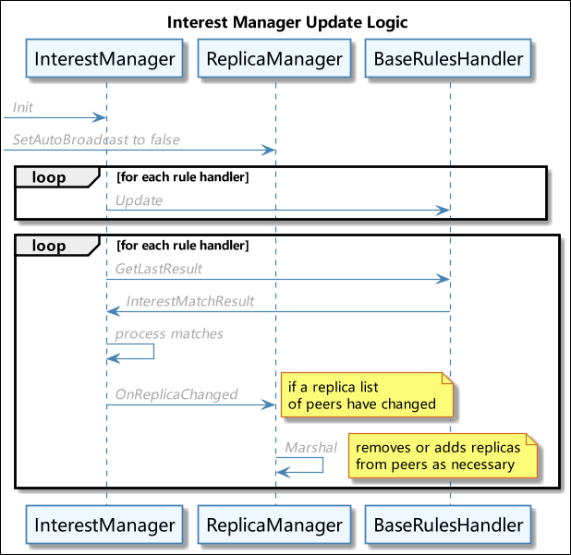
Interest Based Filtering
“interest-based filtering of networked entities in your own application”
interest manager…”control which replicas are broadcast to which peers and under what conditions”

Slide 18
Interest Based Filtering
Attribute: Location and bounds
Rule: a geometrical volume that your client considers in its vicinity of interest.
RuleHandler: smart spatial matching among these spatial objects.

Slide 19
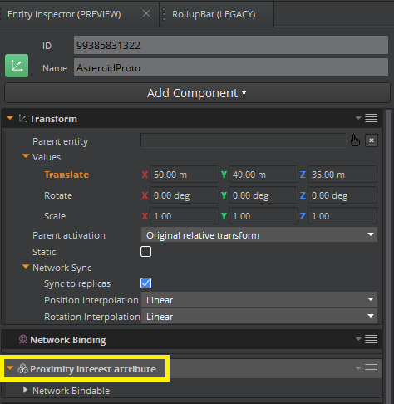
Node
Replica & interest managers
Node
Replica
Replica & interest managers
Secondary
Replica
Node
Primary
Replica
Secondary
Replica & interest managers

Slide 20
APP
data
data
data
APP Hosting (托管平台）
GridMate
data
data
data

